Slide 1
Predicting Temperature Changes in the U.S.

Slide 2
Overview and problem statement
We are interested in setting up a machine learning model to predict average temperatures across the U.S.
We would like to measure the performance of various supervised machine learning algorithms.
We will examine the average land and surface temperature from 1850 until 2020.
Notes:
We are framing this problem in terms of a clear business need. And asking the question, what is this analysis actually going to do for our business, right? Remember, it’s our world, the statistics are just living in it!

Slide 3
Recent Temperature Changes
In 1970, the average land and ocean temperature was 59.6 degrees Fahrenheit.
In 2015, the average temperature increased to 60.9 degrees Fahrenheit.
Global temperature is projected to warm by about 1.5 degrees by 2050 and 3.6 – 7.2 degrees by 2100.
Source: Berkeley Earth Climate Data
Notes:
We are framing this problem in terms of a clear business need. And asking the question, what is this analysis actually going to do for our business, right? Remember, it’s our world, the statistics are just living in it!

Slide 4
Data analyzed
Average Land and Ocean Temperatures in the U.S. between 1850 and 1915.
Data includes average land temperature, minimum land temperature, and the maximum land temperature.
All temperature data has uncertainty boundaries.
Raw data available here
Source: Berkeley Earth Climate Data
Notes:
Set the stage a bit -- where is the data coming from? Be as transparent as possible. Explain to the audience what you were thinking about data collection in terms of what data was necessary and how that in turn shaped your thinking on the kind of analysis that would be most appropriate given the objective.

Slide 5
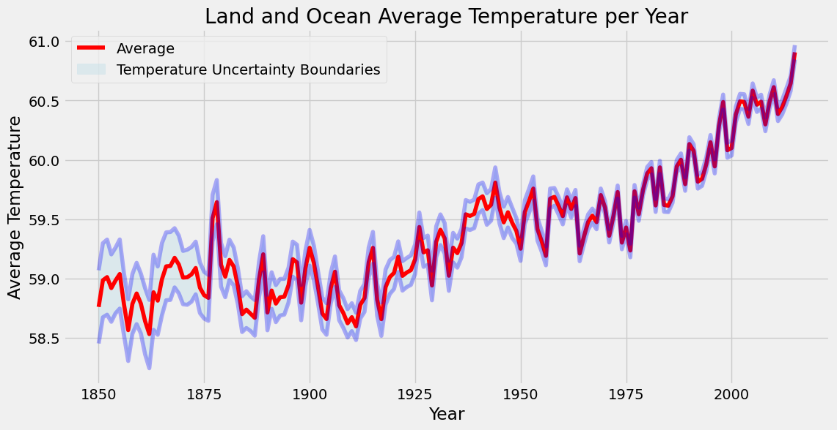
Time Series Plot 1

Slide 6
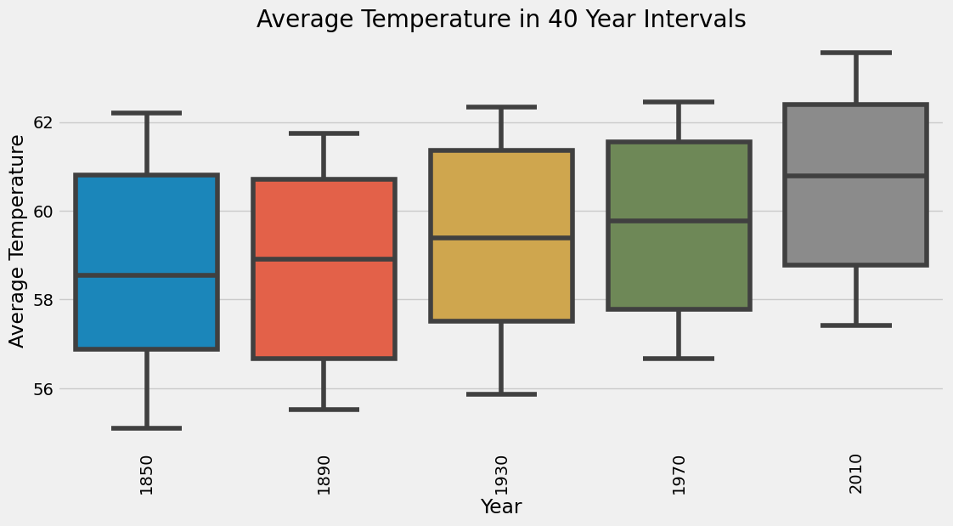
Box Plot 1

Slide 7
Machine Learning Model (Supervised Regression)
Feature variables:
Land Average Temperature (continuous)
Land Minimum Temperature (continuous)
Land Maximum Temperature (continuous)
Target variable:
Land and Ocean Average Temperature (continuous)
Notes:
We are framing this problem in terms of a clear business need. And asking the question, what is this analysis actually going to do for our business, right? Remember, it’s our world, the statistics are just living in it!

Slide 12
Recommendations to mothers
Limit or stop smoking while pregnant to increase health of newborn.
Get regular prenatal checkups.
Eat healthy and stay physically active.
Notes:
Set the stage a bit -- where is the data coming from? Be as transparent as possible. Explain to the audience what you were thinking about data collection in terms of what data was necessary and how that in turn shaped your thinking on the kind of analysis that would be most appropriate given the objective.

Slide 13
Questions?

Slide 14
Thank You

